Slide 1
A few technical points
All lines are muted throughout the webinar
Engage using the chat
  Select CHAT
  all participants and attendees
Use the Q/A for the discussion at the end
This webinar will be recorded; We will send you the slides, recording, & resources following the event
Notes:
Housekeeping: Welcome, we’ll get started at the top of the hour or a minute after. We’re excited to have over xxx people registered for this webinar.
Informal introduction. Let’s get started with housekeeping. You are muted so we can give our full attention to today’s presenters. I encourage you to talk during the presentation, just talk using the Chat function. Any comments you type in will be shared with all attendees and the presenters.
If you have questions for the presenters please use the Q&A so that we have a list of questions for the presenters to answer at the end of our session.
Finally, as always this webinar will be recorded and we’ll send you the link, the slides and any additional resources in the coming days.
All lines are muted throughout the webinar
Engage using the chat
Use the Q/A
This webinar will be recorded
We will send you the slides, recording, & resources following the event

Slide 2
Community Development in Practice
Creating Health Virtual Learning Series
June 7, 2022
Notes:
Welcome to the 4th webinar in our 2022 Creating Health Virtual Learning Series. Today we are pleased to bring you an example of community development in practice, showcasing a collaboration to develope the Renessaince Heights neighborhood in Fort Worth Texas.

Slide 3
Notes:
Before we begin, I want to remind you that the children’s hospital association is more than 220 members strong. Together we are children’s hospitals and go beyond hospital walls by working with communities to support all aspects of children’s health.

Slide 5
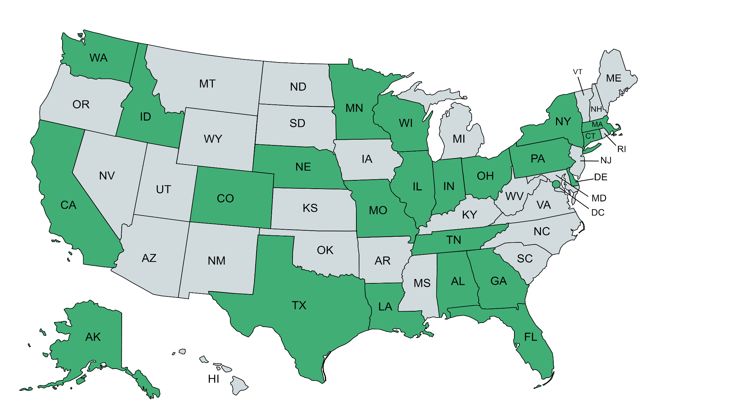
Registrants
Over 138 registrants from more than 49 children’s hospitals in 25 states and the District of Columbia
Notes:
Current registration is at 353

Slide 6
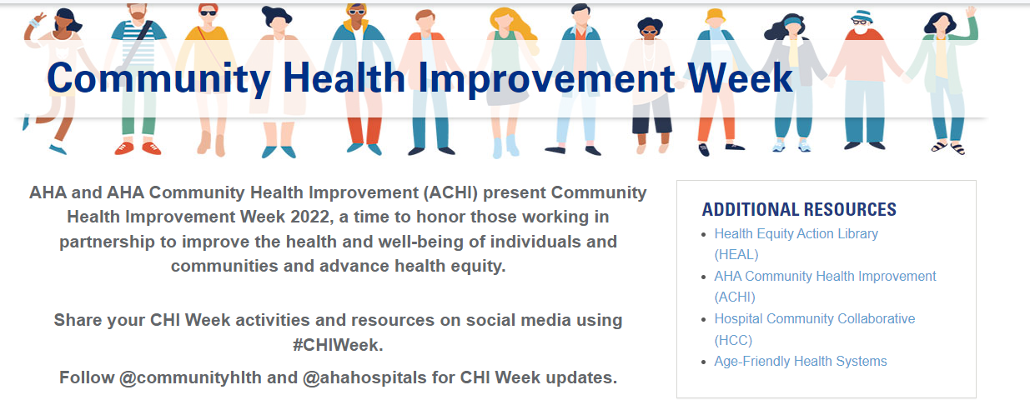

Slide 7
Poll Question
Has your hospital engaged in community development projects?
Yes, we are engaged as the convener or backbone organization
Yes, we are engaged as members of community development coalitions
No, we are still exploring these opportunities and haven’t engaged yet
No, this is not work my hospital is considering at the moment
I’m not from a hospital, I represent a different sector in this work

Slide 8
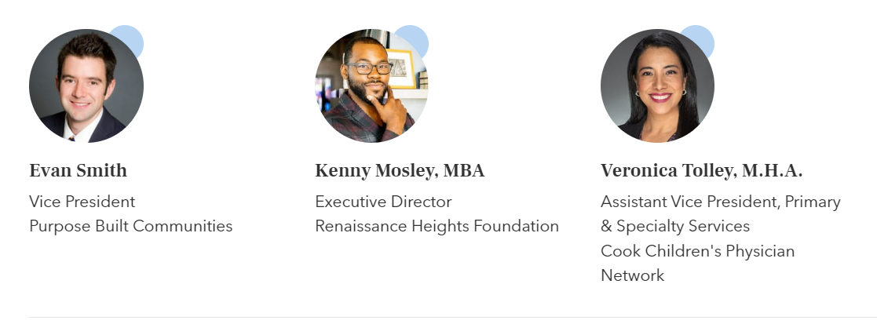
Today’s Presenters

Slide 9
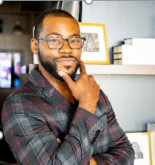
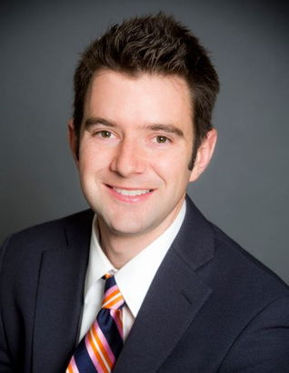
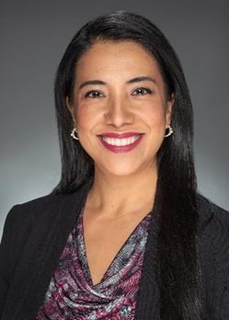
Introductions
Kenny Mosley, Executive Director Renaissance Heights United
Evan Smith, Vice President Purpose Built Communities
Veronica Tolley, Assistant Vice-President
Cook Children’s Physician Network
Notes:
Kenny Slide: Kenny describes his role and history with PB and RHU. Brief Intro of title and role with RHU of the other speakers for today’s presentation

Slide 10
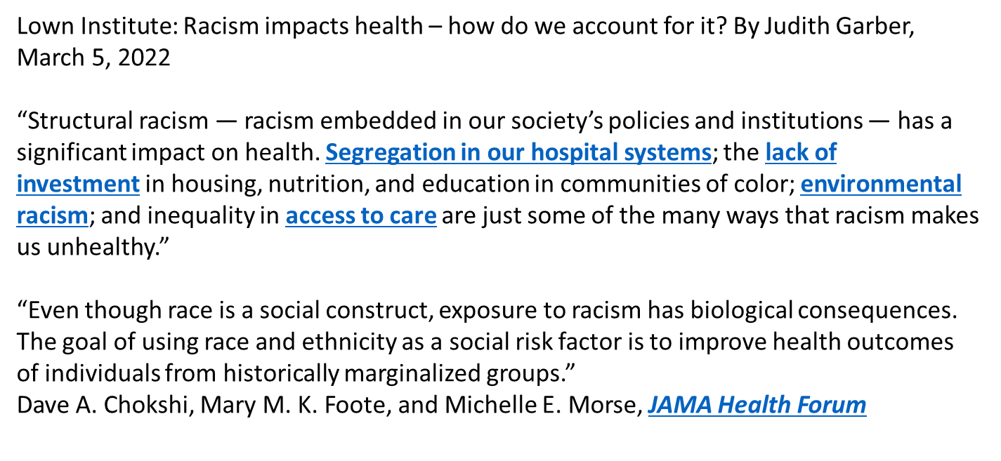
Lown Institute: Racism Impacts Health
Notes:
Kenny’s Slide: brief discussion of why healthcare has a role to play in social justice. Transition to introducing Evan will speak on what the purpose built model is and how it is an ideal vehicle for collaboration with healthcare partners

Slide 11
References:
¹ American Census Survey (2015 – 2019) URL Link
² American Census Survey (2015 – 2019) URL Link
³ U.S. Census Bureau – Table FG10. Family Groups: 2021 URL LINK

Slide 12
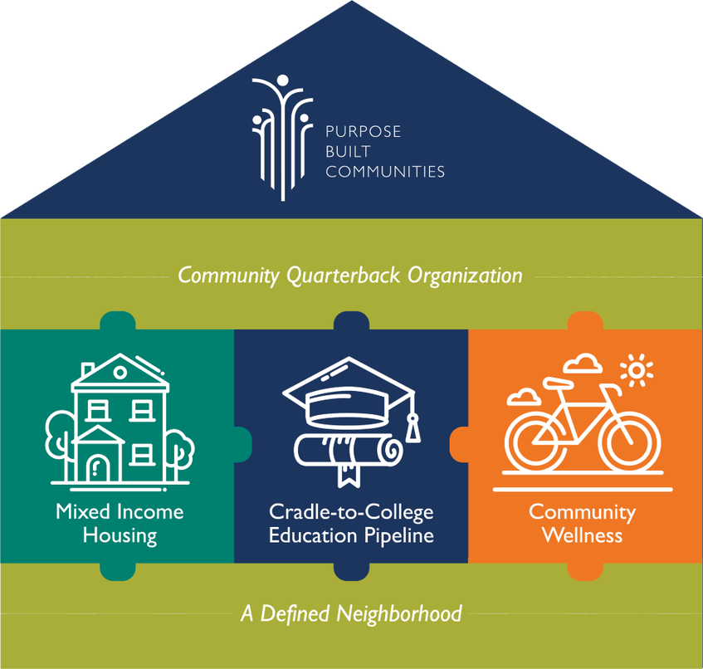

Purpose Built Communities
The Big Idea: Purpose Built Model
To solve complex problems, even great leaders need coaching
Projects and partnerships prosper when there’s a consistent convener
High quality stable housing is an anchor, not an option
Healthy living requires healthy spaces and access to health care
Family income today impacts children’s wealth tomorrow
Zip Code Matters more than Genetic Code
Education unlocks opportunity for generations to come
Notes:
Evan’s Slide: walk thru the model

Slide 13
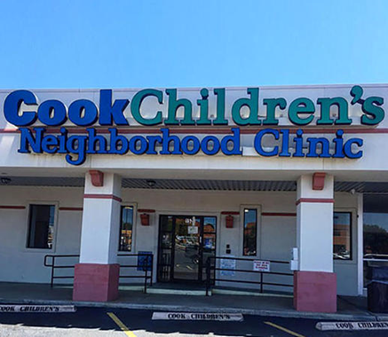
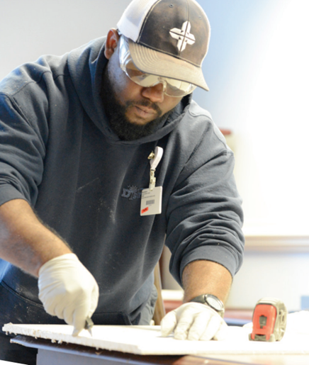
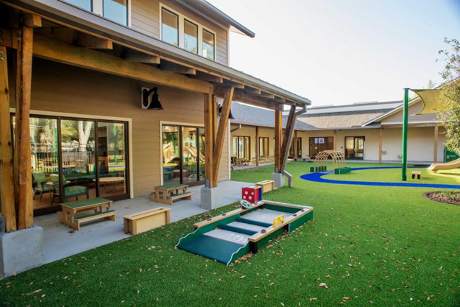

Healthcare Systems Address Social Determinants of Health within the Purpose Built Network
Health care access
Employment opportunities
Early learning
Real estate / housing
Initiative funding
Leadership
Notes:
Evan’s slide 2: describe the role healthcare plays in a quarterback model concept

Slide 14
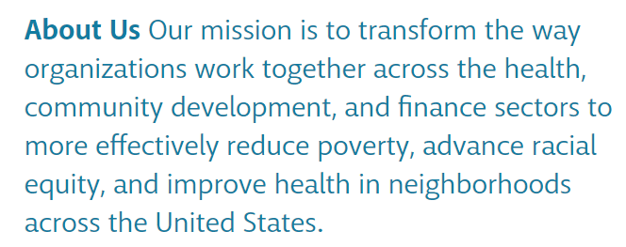

Build Healthy Places Network: Case Study
About Us - Build Healthy Places Network
https://www.buildhealthyplaces.org/about-us/
Notes:
Kenny’s Slide: Brief description that BHPN supports this work thru shared learning and facilitating cross-sector partnerships. RHU is very thankful for the opportunity to have them write a case study on this aspect of our work. Transition here to introducing next speaker Veronica will walk you thru the case study

Slide 15
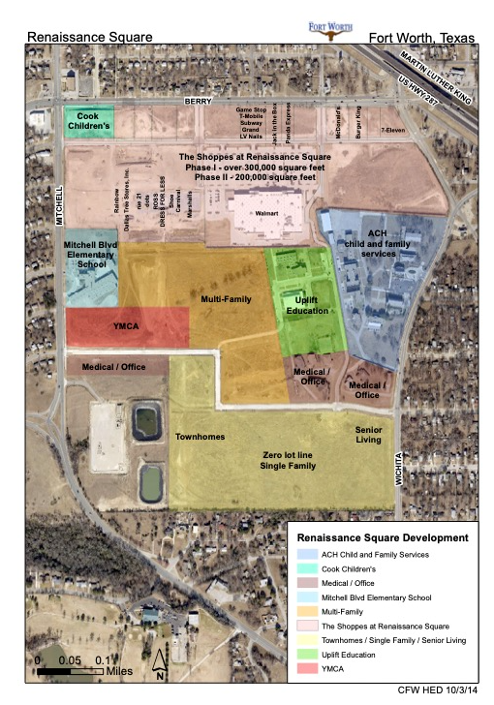
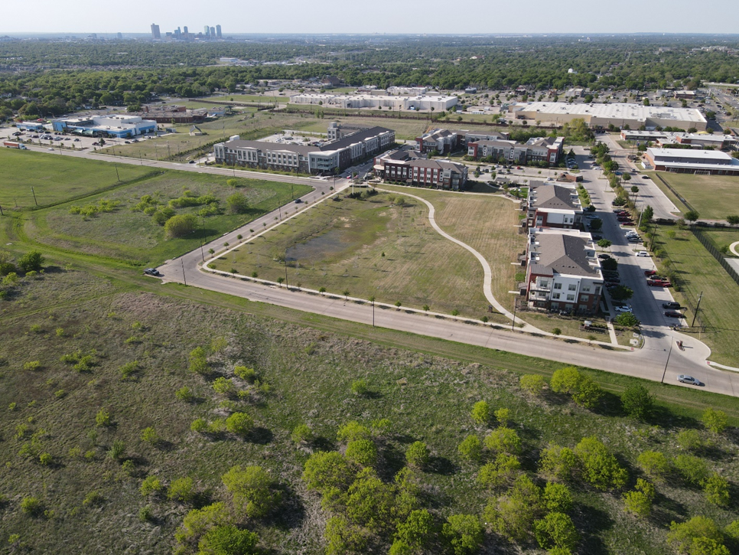
Renaissance Heights: 200 Acres
Notes:
Veronica Slide 1: Located Southeast FW, TX. Site of the Masonic Home and School of Texas originally. Fort Worth Mason Heights Foundation and its partners crafted a shared vision to transform the vacant site into an area of prosperity

Slide 16
Advocating for Policy Action
Texas House Bill 3535: allocate tax-credit financing for inner city revitalization initiatives
Columbia Residential needed tax credits to make the project economically feasible
2014 TDHCA denies application for 9% LIHTC
Notes:
Veronica’s Slide 2: Before this advocacy effort, RHU had lacked a key component of the Purpose Built Communities Model, mixed-income housing
Due to scoring process Qualified Allocation Plan awarded to developers for building in high opportunity areas defined by census tracts with no more than 20% poverty rate and above average performing schools

Slide 17



Texas House Bill 3535 signed into law 2015
TDHCA awards 9% credit to Columbia at Renaissance for Phases 1 and 2
Notes:
Veronica’s slide 3: RHU partners work with state representative Nicole Collier, Councilwoman Kelly Allen Gray in a two year long advocacy effort. establishes annual funding for Texas’ most populous regions with revitalization efforts that are supported by local municipalities. The credit brings $16Million in funding to the housing development project

Slide 18












Demonstrating Mason Heights as a HIGH OPPORTUNITY AREA
Leveraging Cross-Sector Partnerships
Notes:
Veronica’s Slide 4

Slide 19
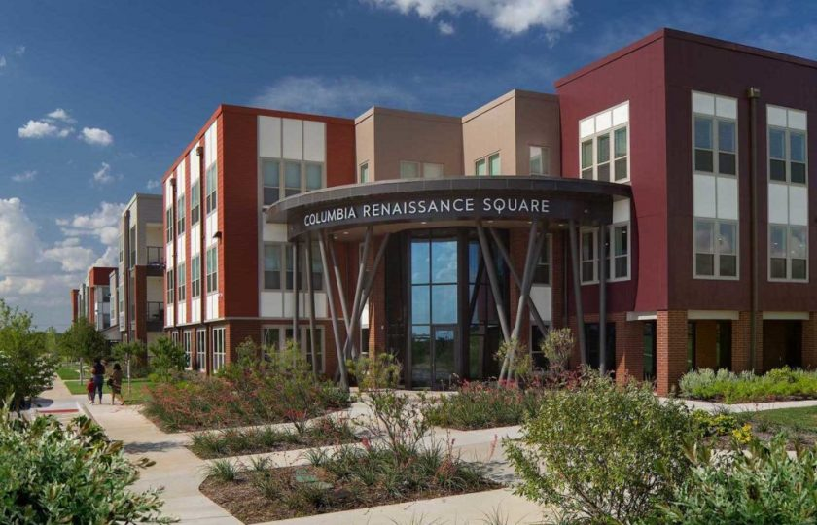
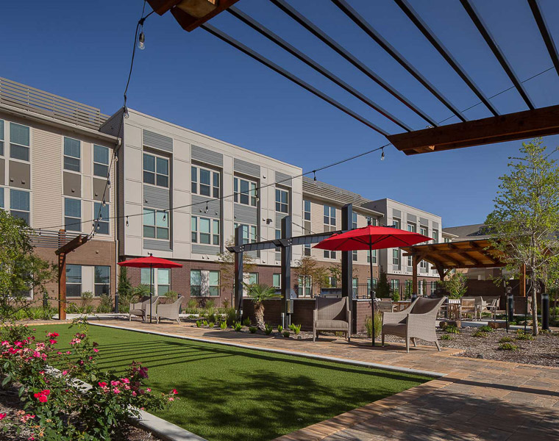
Notes:
Veronica’s Slide 5: 140 Mixed-Income Apartment homes and 120 Affordable Senior Living Apartments. Next active phase building another 140 mixed-income apartments

Slide 20
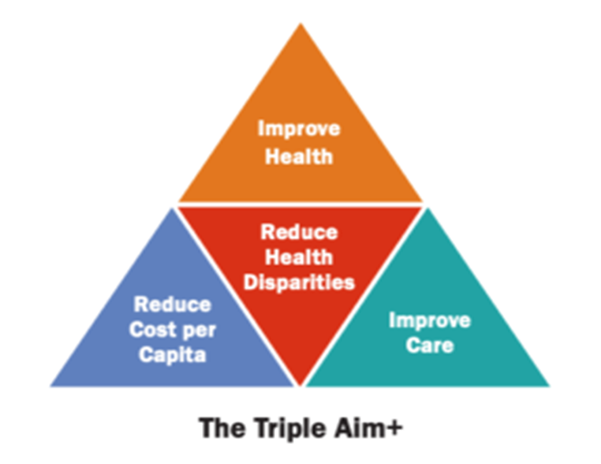
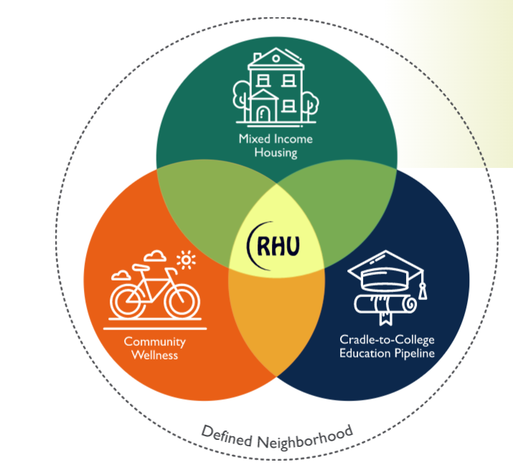
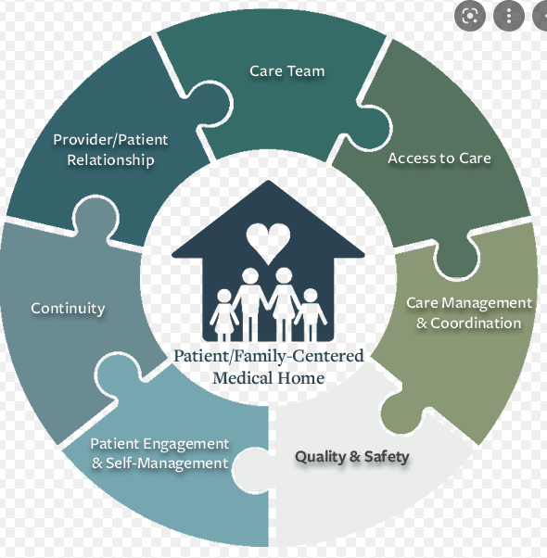
Notes:
Veronica Slide 6: RHU was formed at the community quarterback to convene partners and execute the shared vision based on using the three pillars model. For Cook’s this was a familiar model to PCMH: holistic approach to caring for a patient and Triple Aim: better care for individuals, better health for populations and lower per capita costs

Slide 21
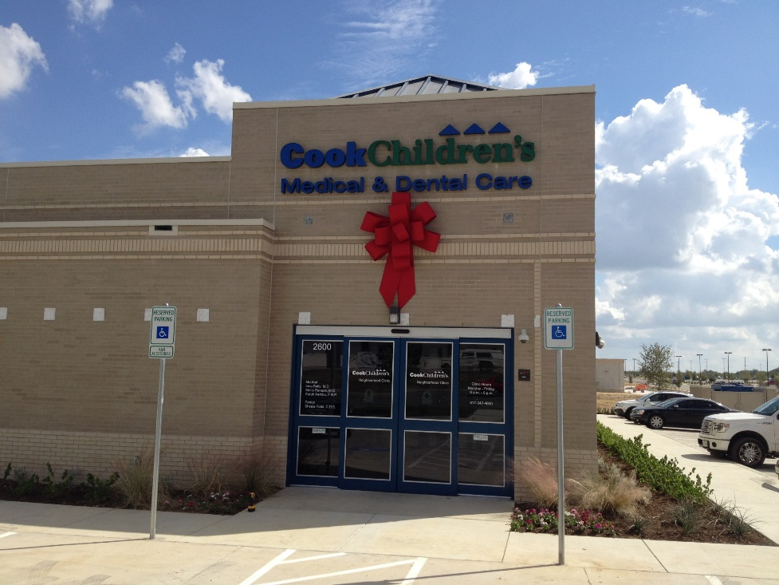
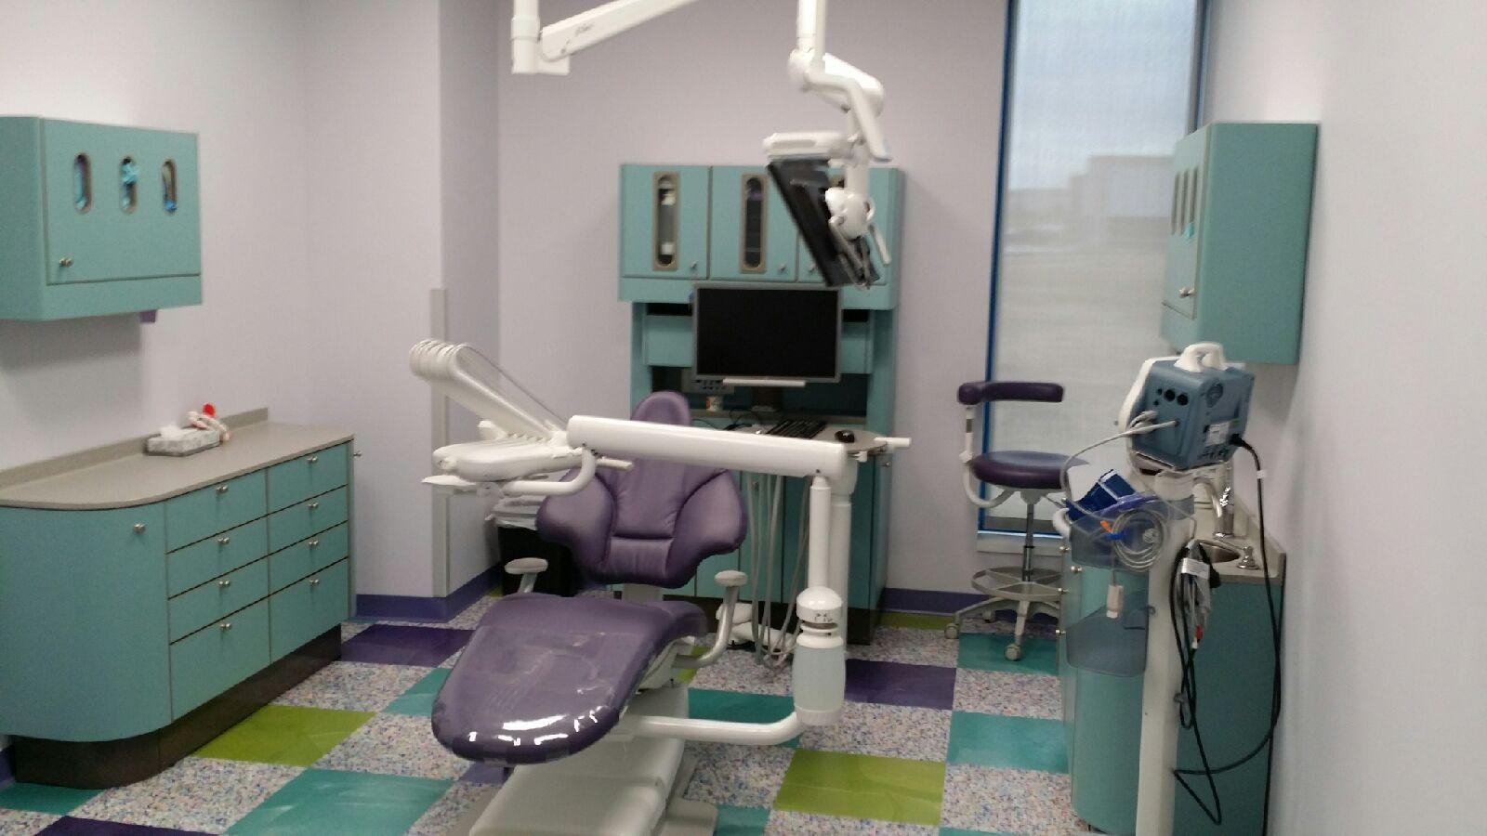
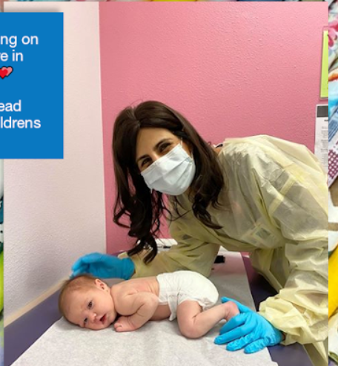
Cook Children’s Renaissance Neighborhood Clinic
Pediatric Dental Care for Patients with Medical Complexities
Patient Centered Medical Home: Primary Care Services
Integrated Behavioral Health
Speech Therapy Evaluation, Nutrition Counseling, and Resource Support
Notes:
Veronica Slide 7: Data defines Cook’s problem: Using ED Utilization by zip code data, Immunization rates, Health plan Utilization and PCP panel size data
Synergy in goals leverages financial opportunities: 1115 Medicaid Waiver project with county hospital district
Today this clinic location serves 8400 unique patients and conducts over 16K visits annually plus 5000 annual dental visits

Slide 22
Take-Aways
Align Vision and Mission Across Partners
Leverage Unique Partnerships to Correlate Actions with desired Outcomes
Be creative in organizational strategic goal planning
Use Data to define needs, make informed decisions about priorities and measure outcomes
Notes:
Veronica’s Slide 8: Alignment helps partners willingness to alter changing timelines for mutual success.
Connecting the dots among cross-sectors for both root cause and outcome potential.
Opportunities exist that compliment community needs in a very tangible way: Kill two birds with one stone
Data Informed direction, measure outcomes and coarse correct

Slide 23
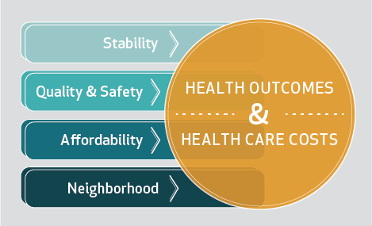
Notes:
Veronica’s Slide 9: Based on the literature we know that external factors like a person’s environment is correlated to health potential. Healthcare has a role to play in SDOH: it can be thru advocacy, aligning resources and being intentional with our system strategies. This project addressed: Food Desert Issue by Bringing Walmart, Education with a charter school and improved public school options, Economy: new jobs thru retailers and restaurants

Slide 24
Cook Children’s Data Review
Community-Wide Children’s Health Assessment & Planning Survey (CHAPPS)
Cook Children’s Health plan Data Review: Healthcare Utilization and Resource Navigation
Comparative Analysis of Emergency Room Utilization, Immunization Rates, Asthma Management Metrics
Notes:
Veronica’s Last Slide 10

Slide 25
Renaissance Heights United: What’s Next
Wellness is beyond HealthCare
  Happy Park Development
Next Phase of Housing Development
  Affordable Rates for Single Family and Townhomes
  Commercial Space Development will bring more resources and RHU partnerships
Fostering Continued Community Engagement
  Platform for Public Health Messaging and Bi-directional Communication with mutual constituencies from all partners
  Leadership Development at all Levels
Notes:
Kenny’s Slide

Slide 26

Notes:
Kenny Opens it up to questions from audience

Slide 27
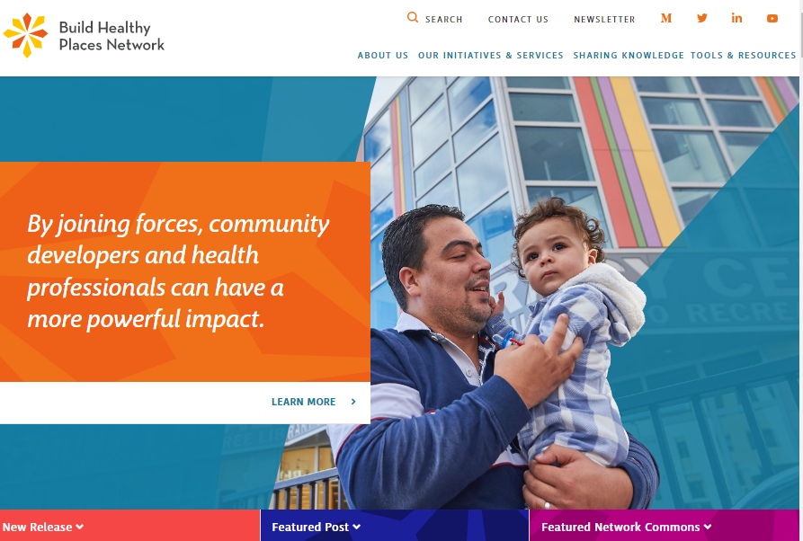

Resources
Build Healthy Places Newsletter
https://buildhealthyplaces.org/

Slide 28

Give us Your Feedback

Slide 29
Stacy Wathen
Manager, Community and Child Health
stacy.wathen@childrenshospitals.org

