Slide 1
A Critical Process for Addressing Dangerous Self-Harm and Suicidality
Counseling Caregivers on the Restriction of Access to Lethal Means
This project was funded under grant number RFA-HA-16-002 from the Agency for Healthcare Research and Quality (AHRQ), U.S. Department of Health and Human Services (HHS). The authors are solely responsible for this document’s contents, findings, and conclusions, which do not necessarily represent the views of AHRQ. None of the authors has any affiliation or financial involvement that conflicts with the material presented in this report.

Slide 2
Why is counseling on restricting access to lethal means important?
Pediatric mental health disorders are becoming a significant issue in healthcare
An estimated 20% of children and adolescents in the United States meet diagnostic criteria for a mental health disorder
Inpatient admissions and hospitalizations for mental health problems among youth increased significantly in the past several decades

Slide 3

Restricting access to lethal means: Recommendation for developing a clinical standard
The American Academy of Child and Adolescent Psychiatry recommends:
Parents/caregivers of children and adolescents admitted to the hospital for suicidality should be counseled on restricting access to lethal means as a minimal standard of care
Studies have shown that clinicians are not trained in and do not routinely counsel on lethal means restriction
Documentation of fact that Lethal Means Restriction Counseling was provided to parents/caregivers can be difficult to produce

Slide 4
Collaborative to improve rate of counseling
Eight children’s hospitals tracked data monthly from January 2018 to January 2019
Measure tested: Restriction of Access to Lethal Means
Children/adolescents who were admitted to the hospital for dangerous self-harm or suicidality should have documentation in the hospital record that their caregiver was counseled on how to restrict the child’s/adolescent’s access to potentially lethal means of suicide (e.g., firearms, medications, car, etc.) prior to discharge.

Slide 5
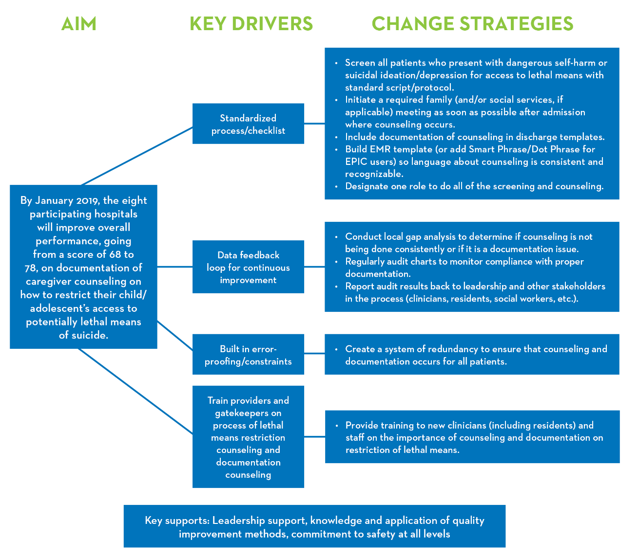
Key Changes Tested

Slide 6
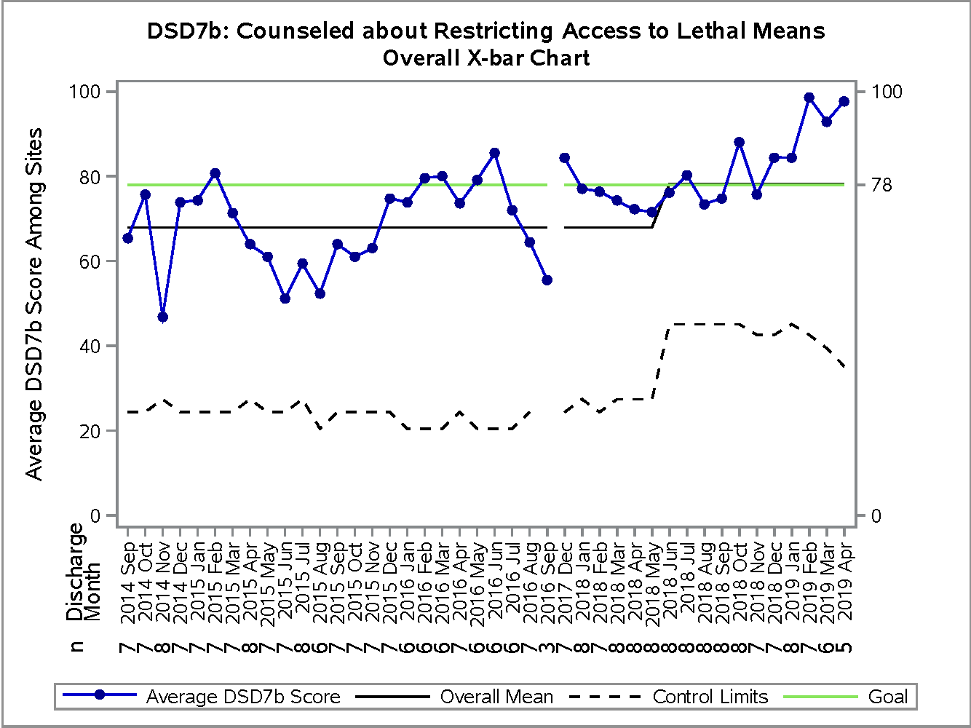
Change Package Based on Collaborative Results
Overall collaborative saw significant improvement in measure score
Four of eight teams saw significant improvement in measure score
All teams indicated that working in the collaborative increased their understanding of the lethal means restriction counseling process
Most teams created valuable resources at their hospitals that can be used by others

Slide 7
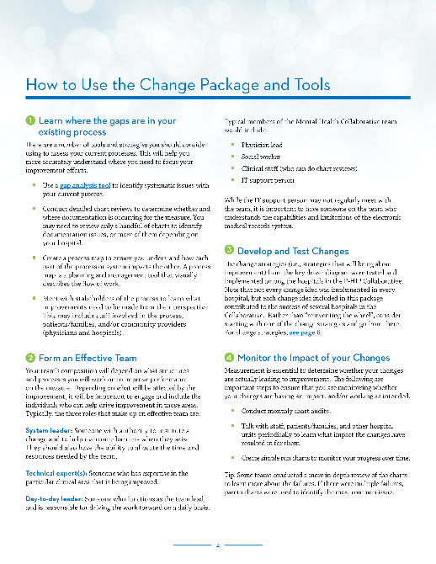
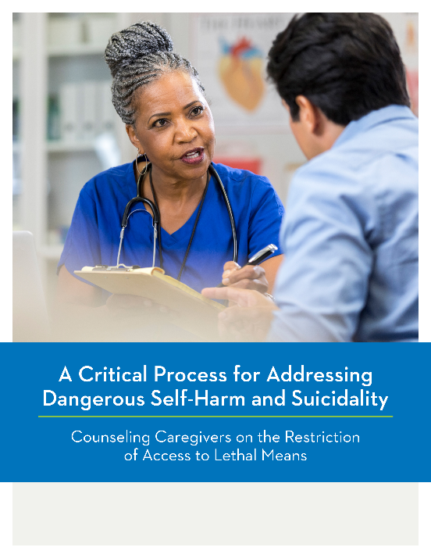
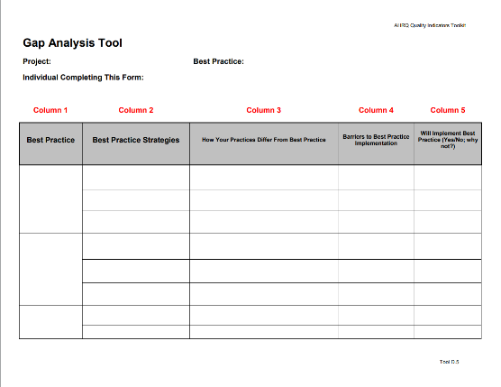
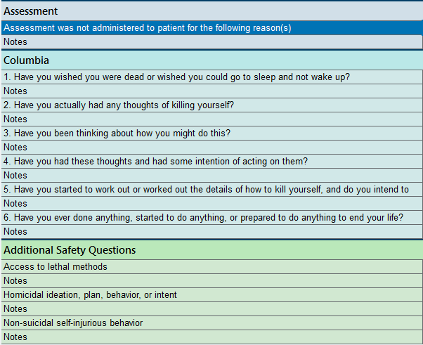
Tools Developed for Change Package
EMR screening templates
Templates to embed in EMR
Dot phrase examples
Clinician training materials
Materials to accompany discharge instructions
Chart auditing reports
Lessons learned, biggest barriers

Slide 8

Who is the intended audience for this Change Package?
Any hospitals that care for children
Freestanding children’s hospitals
Children's Hospitals within General Hospitals
also providing care to adults
Community hospitals
Hospitals seeking to improve their performance on lethal means counseling by improving either the quality of their counseling or the documentation of their counseling

Slide 9

How should the Change Package be used?
The change package offers a starting point to jumpstart improvement efforts at hospitals with varying levels of quality improvement experience and expertise
Hospital teams are urged to select a broad array of strategies and change strategies from within the change package, but are not expected to implement every recommendation
Choose what works for you!

